Slide 1
Abnormal Psychology
Defining and explaining psychological abnormality

Slide 2
Syllabus
Definitions of abnormality
 | Deviation from social norms
 | Failure to function adequately
 | Statistical infrequency
 | Deviation from ideal mental health

Slide 3
On the board!
What is Abnormal?
So you would be classed as abnormal!

Slide 4
Definitions of abnormality, including deviation from social norms, failure to function adequately and deviation from ideal mental health, and limitations of these definitions of psychological abnormality
Deviation from social norms
Failure to function adequately
Deviation from ideal mental health
Limitations of these definitions of psychological abnormality

Slide 5
Deviation from social norms
Expected ways of behaving in society
‘Rules’ of society:
  Written (explicit) laws
  Unwritten (implicit) but generally accepted way of behaving
E.g. Not standing too close to someone when you are speaking to them.
Dressing is a particular way.

Slide 6
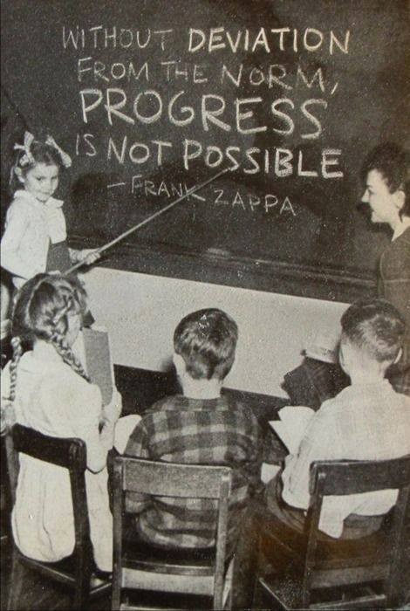

Slide 7
“Whenever you find yourself on the side of the majority, it is time to pause and reflect.”― Mark Twain

Slide 8
Limitation
Social norms differ between cultures: Lip plates in the Suri tribe
Another limitation of the deviation of social norms definition is that norms can vary over time. This means that behaviour that would have been defined as abnormal in one era is no longer defined as abnormal in another. Eg: Homosexuality was classed as mental disorder until 1972
Would a Tourette's sufferer mean that a person is abnormal?

Slide 9
Deviation from Ideal Mental Health:
This definition states that mentally healthy people possess certain characteristics and anyone who deviates from the ideal picture is abnormal. Such characteristics include: self actualisation (reaching your potential), autonomy (the ability to function alone) and self esteem.

Slide 10
Marie Jahoda
Marie Jahoda introduced this definition of abnormality asking why, if we can see that someone is physically unhealthy, why can’t we do the same for mental health?
Jahoda came up with a list of 6 criteria you need to meet in order to not be “abnormal”:
Self attitudes – Having high self-esteem and a personally identity
Personal growth and self actualisation – How much you develop to your full capabilities
Integration – Being able to cope with stressful situations
Autonomy – Being independent and able to look after yourself
An accurate perception of reality – seeing life as it really is, not in a way no one else perceives it.
Mastery of the environment – being able to adjust to new environments.
If you lack any of these things Jahoda said you are abnormal
Who here is normal?

Slide 11
Limitation
The characteristics are very strict and it is unlikely that many people would be able to meet them all, thus being defined as abnormal.
The definition was based on Jahoda’s views of psychological health and therefore represents a very Western view.

Slide 12
Failure to function adequately
Society has expectations and obligations about how one should live their lives and contribute to society and if people do not meet the obligations they are considered abnormal.

Slide 13
Failure to Function Adequately:
Limitations
Context is very important when deciding whether someone is functioning adequately;
what may seem irrational in one context can be seen as rational in another. This limits the definition.
Cultural relativism is an issue, what is considered adequate in one culture is not necessarily adequate in another. This also makes it difficult for this to be a universal definition.

Slide 14
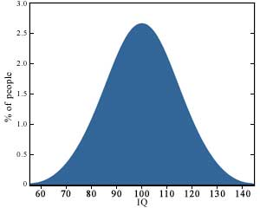
Statistical Infrequency
If you are too intelligent or not so intelligent then you are abnormal?

Slide 15
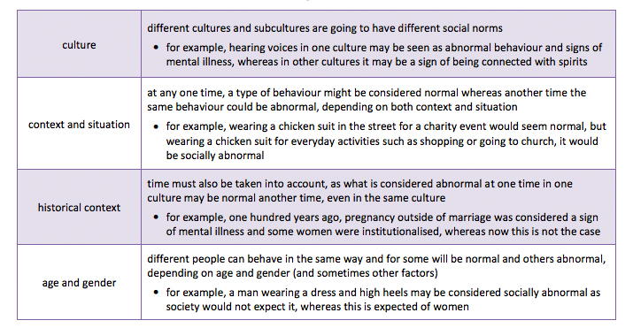
Is this always true

